Slide 1


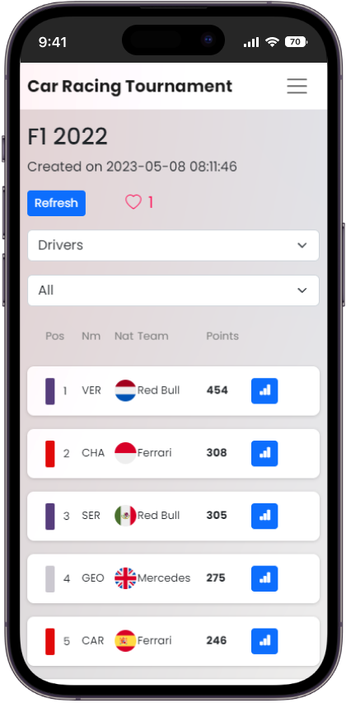

Car Racing Tournament
Topic selection
Frontend
System of points
Replace Excel
Transparency
Dynamism
Centralisation
Zsigmond Máriás
Lead teacher
Levente Nyírő
Computer Science BSc
Backend

Slide 2
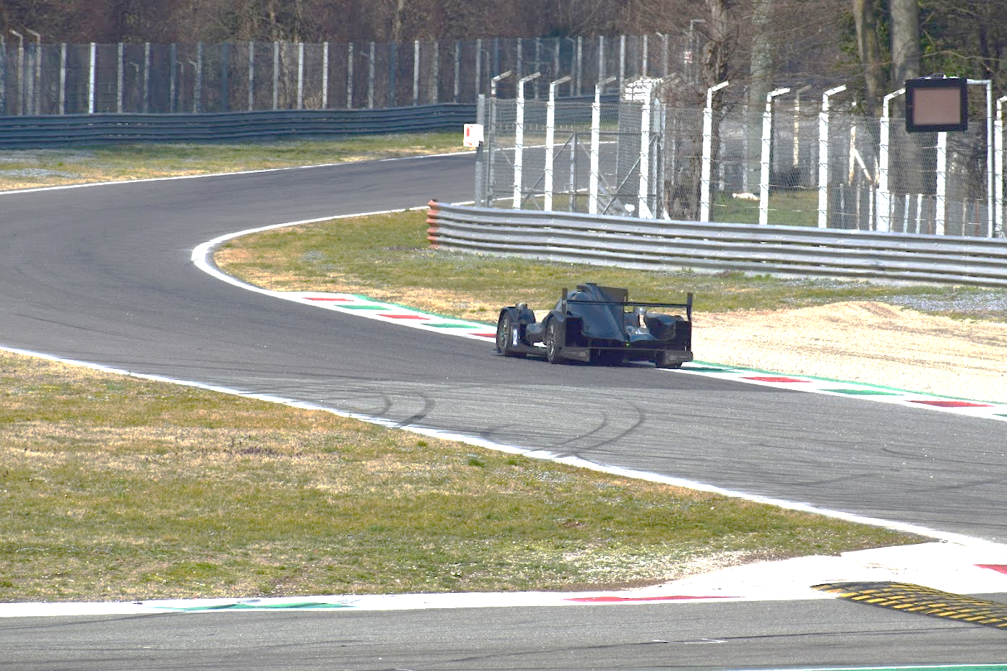
Car Racing Tournament
Frontend
Technologies
Topic selection
System of points
Replace Excel
Transparency
Dynamism
Centralisation
Máriás Zsigmond
Témavezető
Nyírő Levente
Programtervező informatikus BSc
Backend

Slide 3
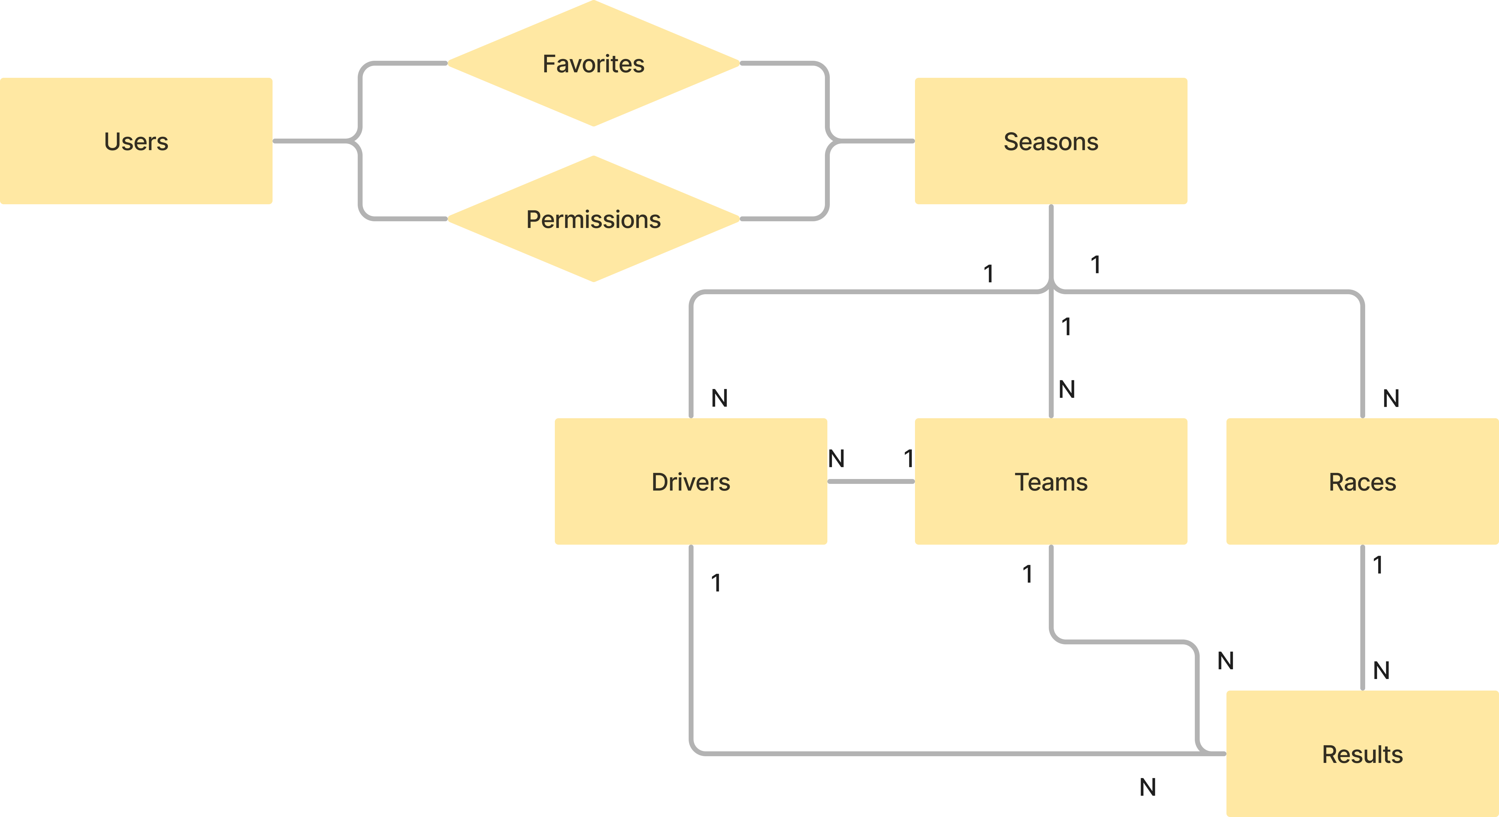
Datamodel
Technologies
Topic selection
Frontend
System of points
Replace Excel
Transparency
Dynamism
Centralisation
Backend

Slide 4
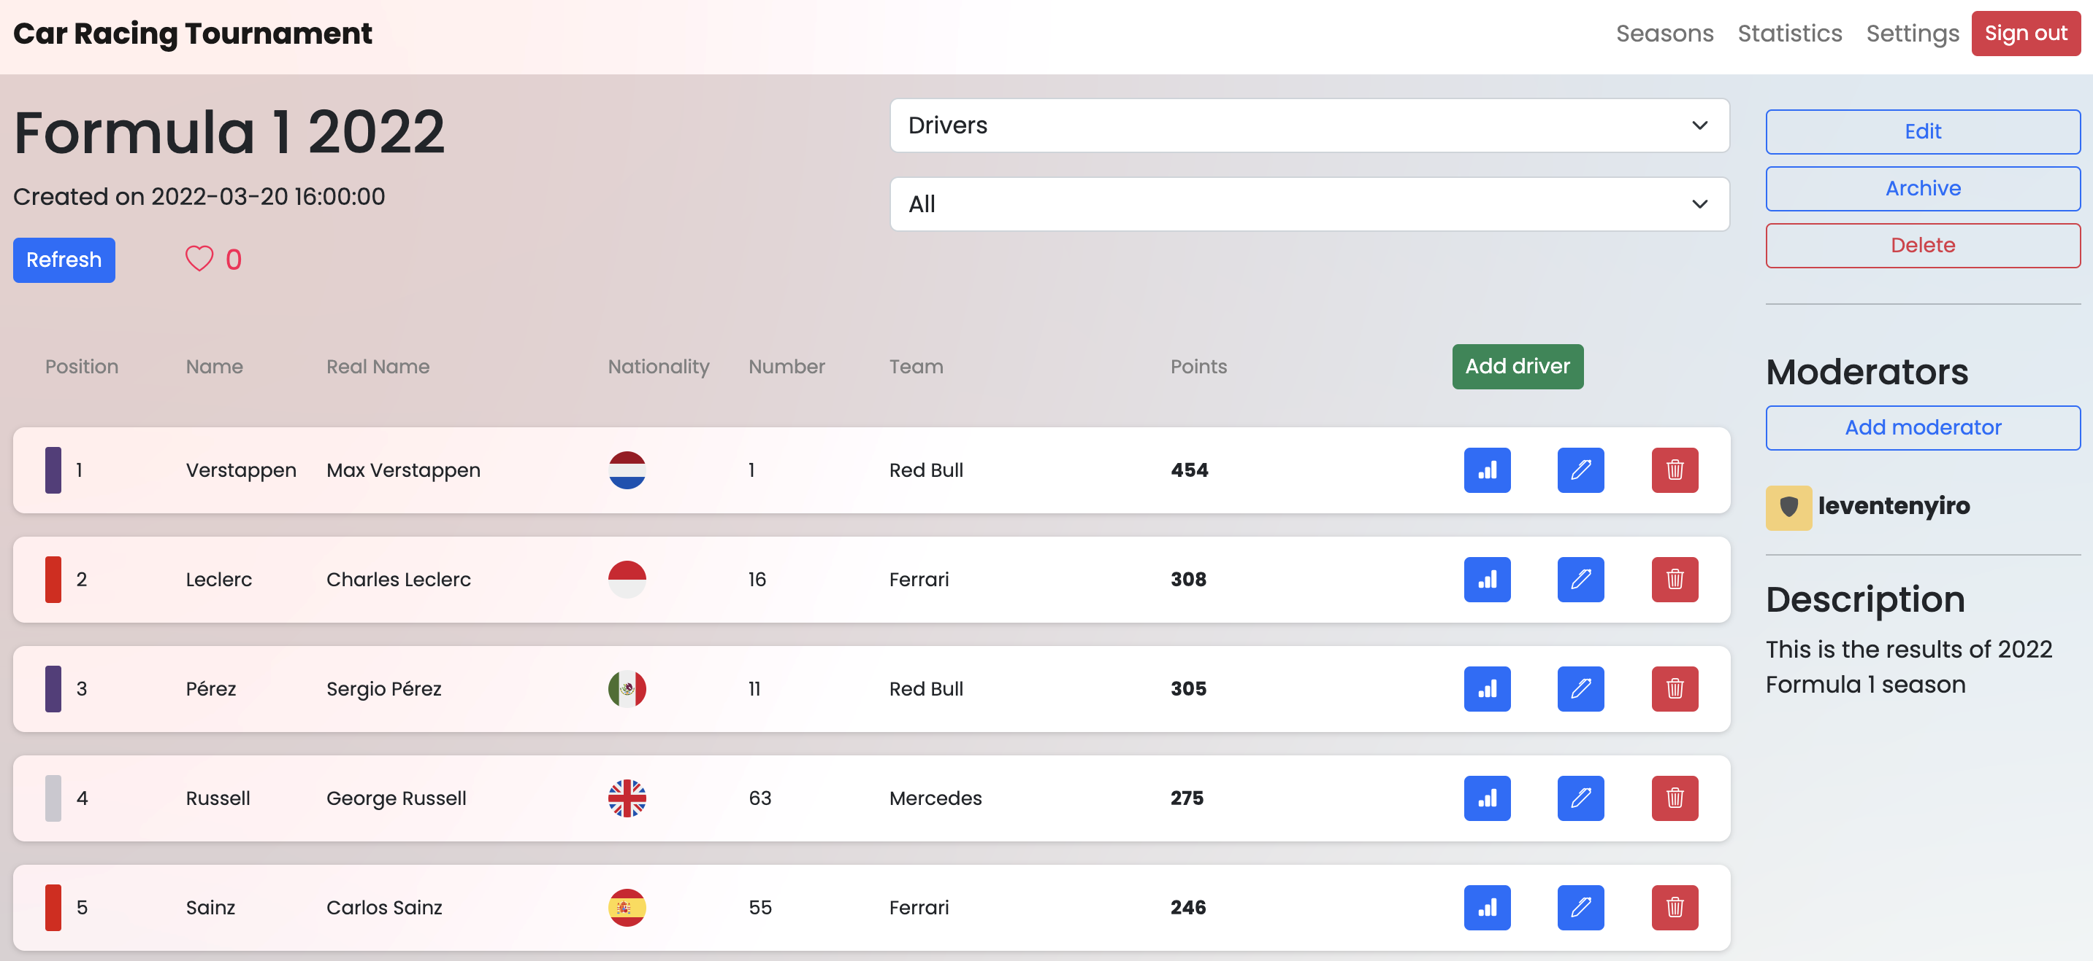
Responsivity
Datamodel
Technologies
Frontend
Backend

Slide 5
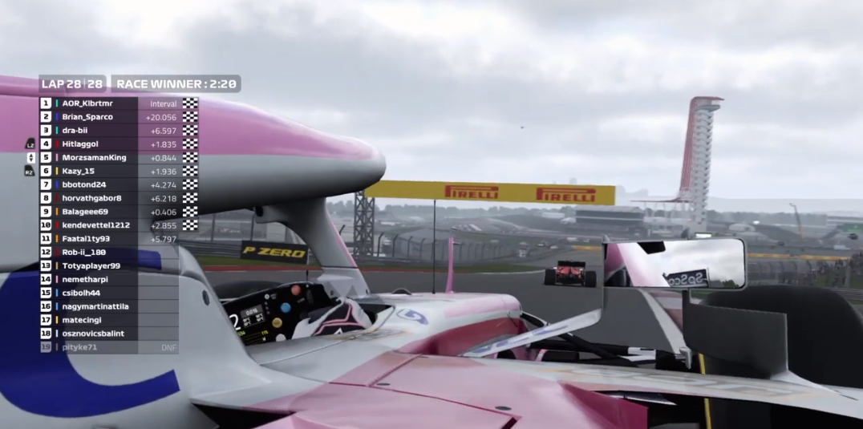
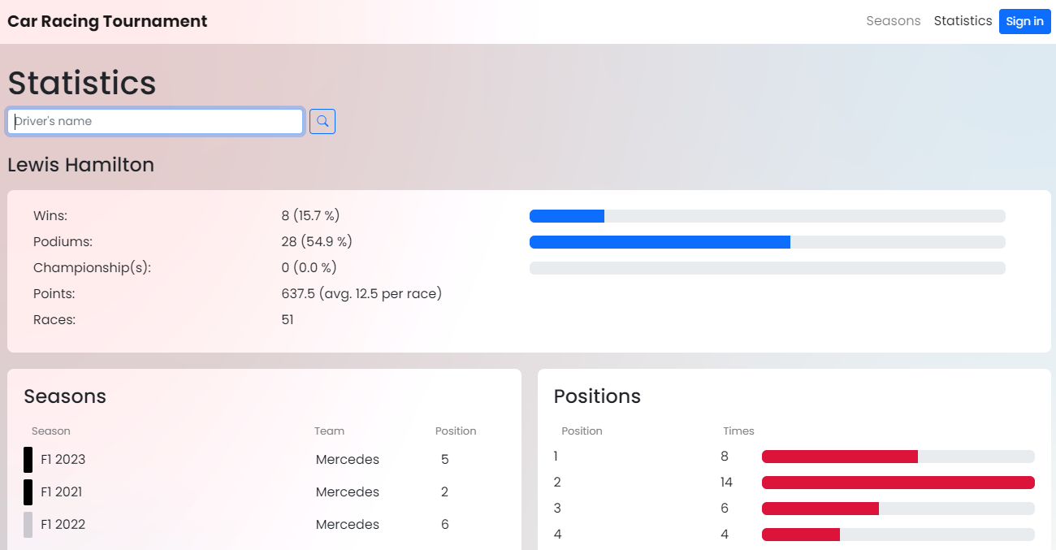
Thank you for attention!
Responsivity
Adatmodell

Slide 6
Thank you for attention!
Responsivity

